Slide 1
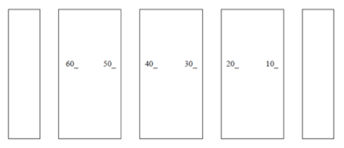
Experiment:
What’s My Formula?
Chem 108: Lab
Week 7
Sign in; PICK UP papers,
Check Group # on the roster, and go to that Group’s lab location below.
Front of Lab
B
C
D
E
F
G
Introduce yourself to your Group members.

Slide 2
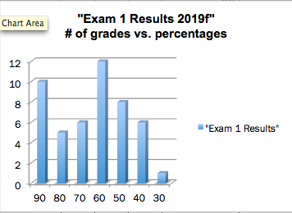
Divide raw score by 115 and multiply by 100 for Normalized %.
WEDS. lab-
Pick up Exam 1 from the Pendaflex file
Class Average = 70.0 % (Normalized)
StdDev = +/-18
Pick up Notes & P.T. if you turned them in.

Slide 3
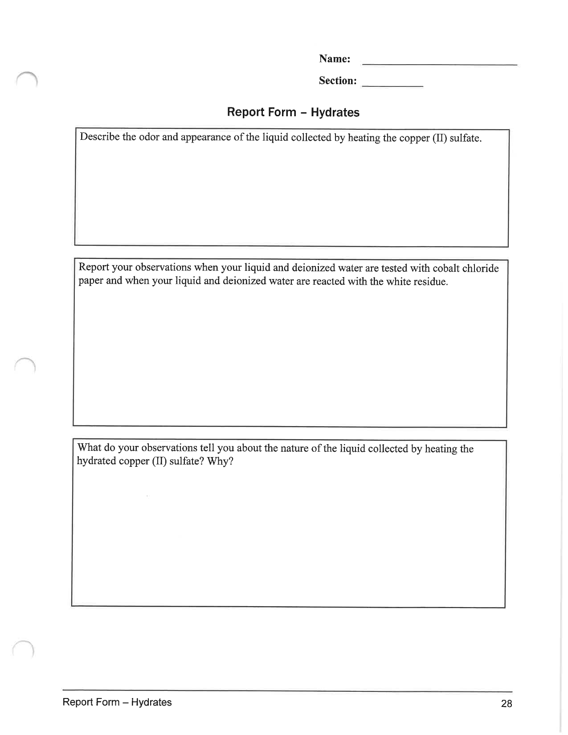
Experiment 4: Hydrates
DUE Today
Report Form: One form for each lab partner who did the unknown from last week are both to be turned in; Place your partner’s name next to yours & staple forms together.
  Check sig figs are correct and units included
  Show calculations
  Answer post lab question; show calculation.
Include completed Replacement Page (pg. 29)
Nomenclature:
Entire Group is to turn in one set of Lab manual pages 109-114 with the names of only those who contributed.
DUE End of Next Lab

Slide 4
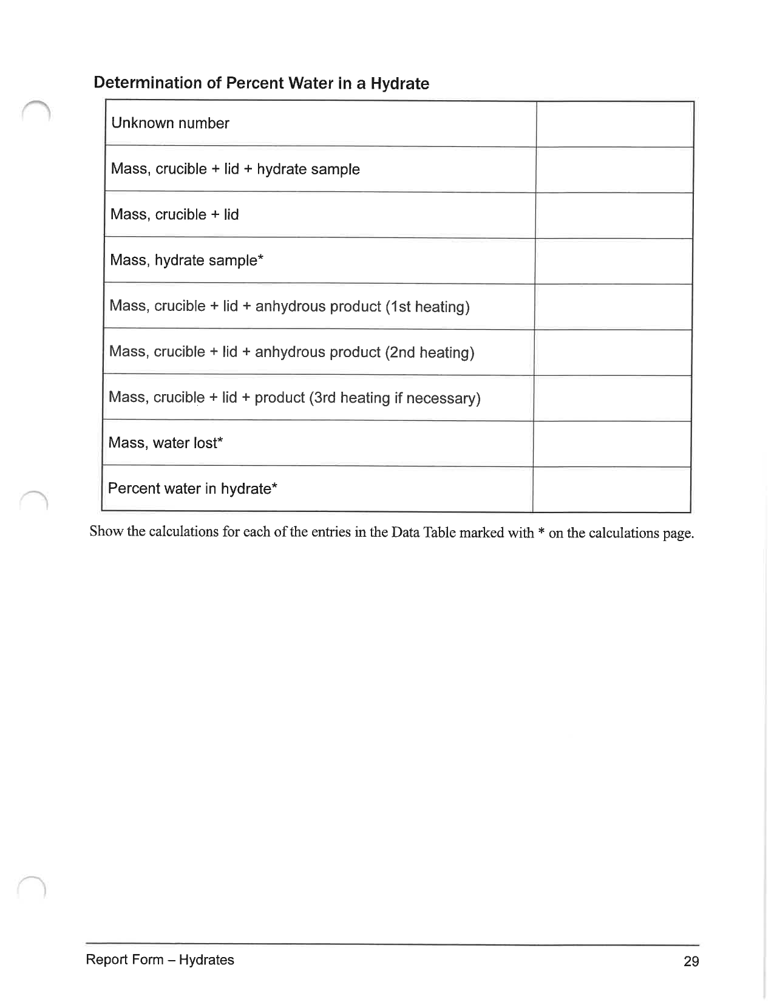
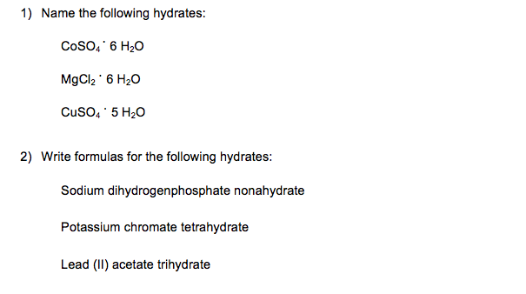
Hydrates Report
include the 2 Replacement pgs.: pp. 29
with the Report

Slide 5
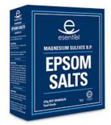
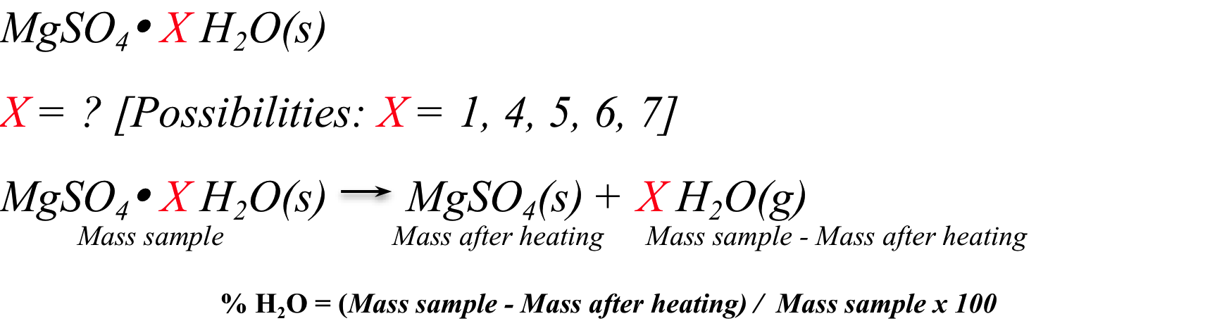
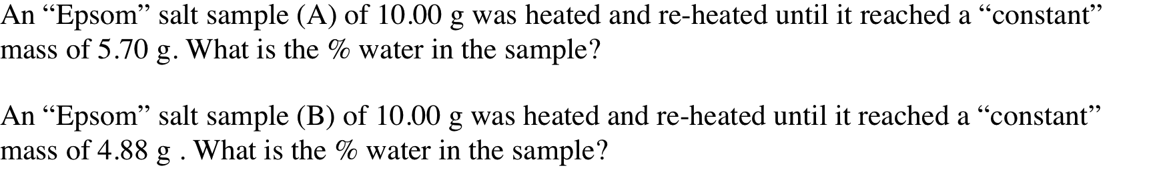
Hydrate: % Water
EPSOM SALT(s)
How can you identify (A) and (B) among the 5 choices?

Slide 6
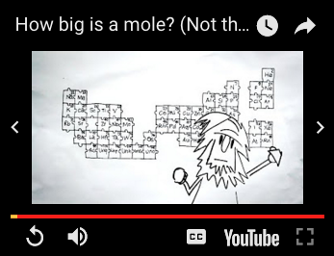
Moles & Mass
http://chemconnections.org/general/chem108/Mole%20Guide.html
How big is a mole?
(Not the animal, the other one.) - Daniel Dulek
https://www.youtube.com/watch?v=TEl4jeETVmg

Slide 7
The Mole
Definition: The number of carbon atoms in exactly 12 grams of pure ¹²C. The number equals 6.02 × 10 ²³ atoms.
1 mole = 6.02 × 10 ²³ units of anything
6.02 × 10 ²³ “units” of atoms, people, ants, stars, $$$s, etc., etc. = 1 mole
There are about 7.7 billion people in the world.
(~300,000 being added every day.)
How many moles of people are there?
https://www.worldometers.info/world-population/

Slide 8
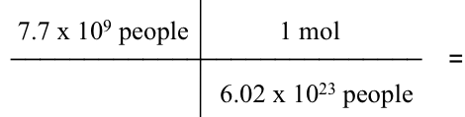

The Mole
There are about 7.7 billion people in the world.
(+300 million since the spring.)
How many moles of people are there?
6.02 × 10 ²³ “units” of atoms, people, ants, stars, $$$s, etc., etc. = 1 mole

Slide 9
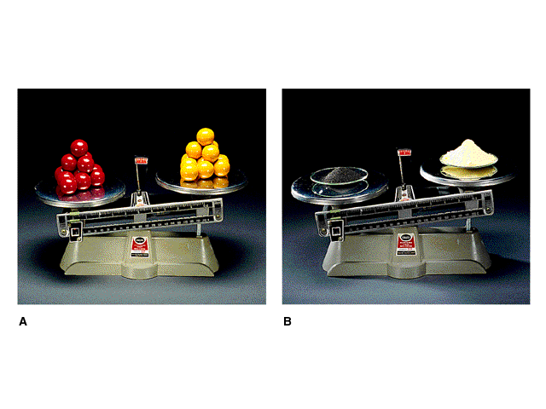
Counting by Weighing
12 red marbles @ 7g each = 84g
12 yellow marbles @ 4g each=48g
55.85g Fe = 6.022 x 10²³ atoms Fe
32.07g S = 6.022 x 10²³ atoms S
Consult the Periodic Table

Slide 10
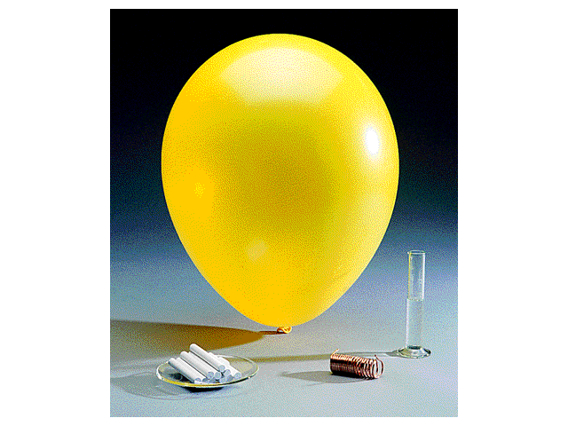
Relative Masses of 1 Mole
CaCO₃ Name?
100.09 g
Oxygen
32.00 g
Copper
63.55 g
Water
18.02 g
1 mole of an “ideal” gas
equals
22.4 Liters.
(A balloon diameter
of 35 cm.)
What is the volume of
1 mole of water?

Slide 11
Atomic and Molecular Weights
Mass Measurements
¹H weighs 1.6735 x 10⁻²⁴ g and ¹⁶O 2.6560 x 10⁻²³ g.
  DEFINITION: mass of ¹²C = exactly 12 amu.
  Using atomic mass units:
1 amu = 1.66054 x 10⁻²⁴ g
1 g = 6.02214 x 10²³ amu

Slide 12
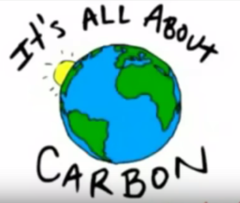
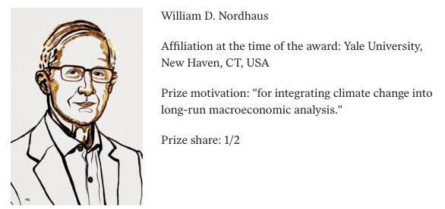
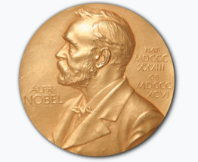

Atomic and Molecular Weights
Mass Measurements
https://www.youtube.com/watch?v=ypbb9Zi5Tao&list=PLE7B4FAD08F1EBCE2
  DEFINITION: mass of ¹²C = exactly 12 amu.
. 10/8/18
$$ ¹²C:CARBON $$
Recent United Nations report to world leaders, continues to describe economic worsening due to food shortages, increased wildfires, hurricanes, typhoons, accelerated extinctions, and a mass die-off of coral reefs as soon as 2040 due to an increase in temperature by as much as 2.7 degrees Fahrenheit (1.5 degrees Celsius)
http://www.ipcc.ch/report/sr15/

Slide 13

https://www.pbs.org/newshour/show/world-needs-to-make-near-revolutionary-change-to-avoid-imminent-climate-disaster-is-there-hope

Slide 14
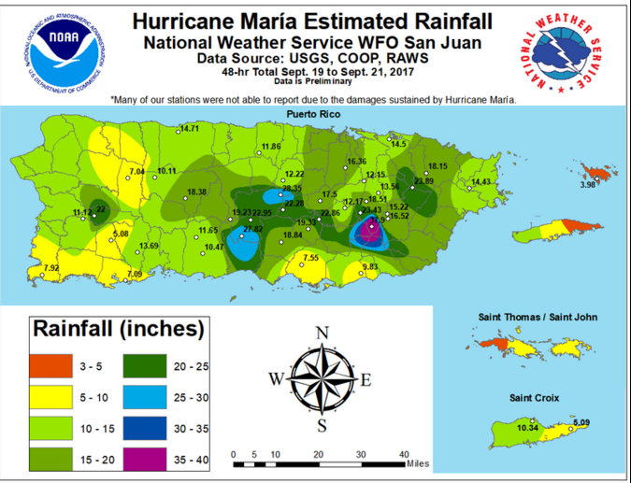
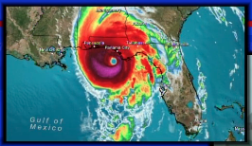
Hurricane Michael
2018
Hurricane Maria
2017
https://www.pbs.org/newshour/show/world-needs-to-make-near-revolutionary-change-to-avoid-imminent-climate-disaster-is-there-hope
Notes:
https://www.nytimes.com/2018/10/08/us/fema-disaster-recovery-climate-change.html?emc=edit_clim_20181010&nl=climate-fwd&nlid=4745526020181010&te=1
https://www.nytimes.com/section/climate?emc=edit_clim_20181010&nl=climate-fwd&nlid=4745526020181010&te=1

Slide 15
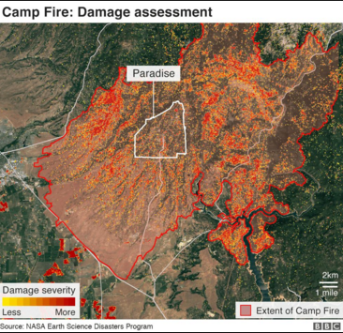

FEMA has provided at least $81 billion to state, territorial and local governments in response to declared disasters since 1992: to rebuild in place, often in defiance of the effects of climate change.
Camp Fire CA
November 2018
Hurricane Michael
10/10/2018
https://www.pbs.org/newshour/show/world-needs-to-make-near-revolutionary-change-to-avoid-imminent-climate-disaster-is-there-hope
Notes:
https://www.nytimes.com/2018/10/08/us/fema-disaster-recovery-climate-change.html?emc=edit_clim_20181010&nl=climate-fwd&nlid=4745526020181010&te=1
https://www.nytimes.com/section/climate?emc=edit_clim_20181010&nl=climate-fwd&nlid=4745526020181010&te=1

Slide 16
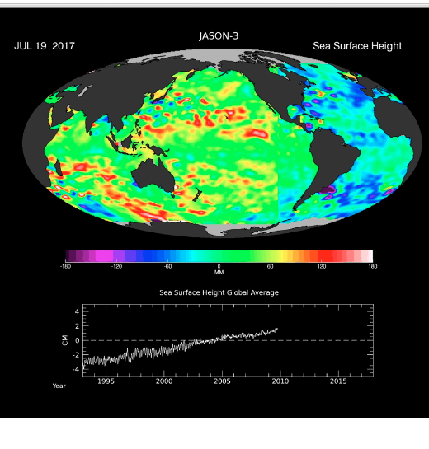
25 Years of Global Sea Level Data
https://www.jpl.nasa.gov/images/topex/20170810/topex-jason20170810-16.gif
Notes:
https://www.nytimes.com/2018/10/08/us/fema-disaster-recovery-climate-change.html?emc=edit_clim_20181010&nl=climate-fwd&nlid=4745526020181010&te=1
https://www.nytimes.com/section/climate?emc=edit_clim_20181010&nl=climate-fwd&nlid=4745526020181010&te=1

Slide 17
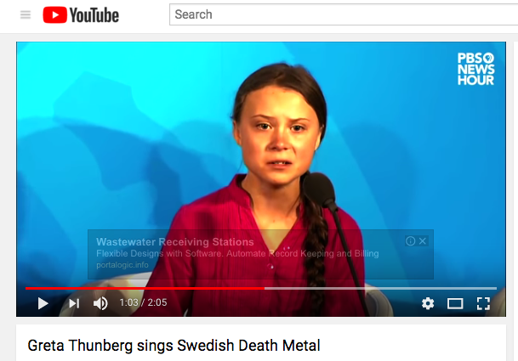

https://www.youtube.com/watch?v=KAJsdgTPJpU
https://www.youtube.com/watch?v=CLxpgRqxtEA

Slide 18
Atomic and Molecular Weights
Formula Weight a.k.a. Molecular Weight
Formula weights (FW): sum of Atomic Weights (AW) for atoms in formula.
FW (H₂SO₄) = 2AW(H) + AW(S) + 4AW(O)
= 2(1.0 amu) + (32.0 amu) + 4(16.0 amu)
= 98.0 amu

Slide 19
Atomic and Molecular Weights
Molecular weight (MW) is the weight of the molecular formula in amu.
MW of sugar (C₆H₁₂O₆ ) = ?
MW = 6(12.0 amu) + 12(1.0 amu) + 6(16.0 amu)
= 180 amu

Slide 20
Molar Mass
(amu/mol = grams/mol)
A substance’s molar mass is the mass in grams of one mole of the element or compound. (Equals the formula weight: atomic or molecular weight in grams)
Molar Mass CO₂ = ?
C = 12.01 grams per mole (g/mol)
O = 16.00 grams per mole (g/mol)
      CO ₂ = 44.01 grams per mole (g/mol)
      12.01 + 2(16.00) = 44.01 g/mol

Slide 21
Calculate the molar mass of magnesium sulfate.
What do you need ?
1) Formula of magnesium sulfate:
MgSO₄
2) Atomic Weights
Mg = 24.31, S = 32.07, O = 16.00
24.31 g/mol + 32.07 g/mol + 4(16.00 g/mol) =
120.38 g/mol

Slide 22
Calculate the mass in grams of 4.00 moles of water.
What do you need ?
Atomic Weight H₂O (2H=1.0 x2) + (O=16.0)
(molar mass) = 18.0 g/mol
4 mol _{sulfur} x 18.0 g/mol _{sulfur} =
72.0 g

Slide 23
Calculate the mass in grams of 0.100 moles of magnesium sulfate hydrate.
What do you need ?
Atomic Weight MgSO₄. H₂O = 120.38 + 18.02
(molar mass) = 138.40 g/mol
0.100 mol _{MgSO4}. _{H2O} x 138.40 g/mol _{MgSO4}. _{H2O} =
13.84 g

Slide 24
Calculate the mass in grams of 0.100 moles of magnesium sulfate tetrahydrate.
What do you need ?
Atomic Weight MgSO₄. 4H₂O = 120.38 + 4(18.02)
(molar mass) = 192.44 g/mol
0.100 mol _{MgSO4. H2O} x 192.44 g/mol _{MgSO4. H2O} =
19.244 g

Slide 25
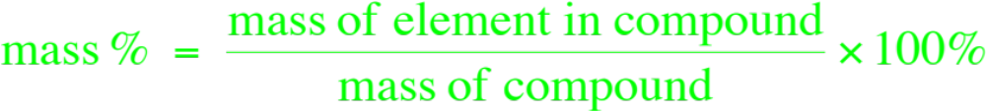
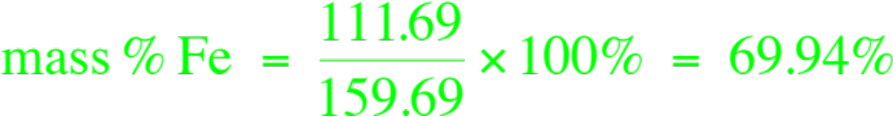
Percent Composition
Mass percent of an element:
For iron in iron (III) oxide = ?
Fe₂O₃
Which iron ore would you buy: one high in Fe₂O₃ or one high in Iron (II) oxide?
FeO
55.84 / 71.84 x 100 = 77.7%

Slide 26
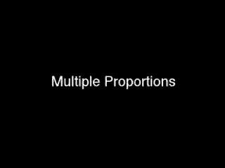
Formulas: Multiple Proportions
http://chemconnections.org/general/movies/multiple-proportions.MOV

Slide 27
Hydrate: % Water
EPSOM SALT(s)
How can you identify (A) and (B) among the 5 choices?

Slide 28
Percent Composition
Calculate the percent water in magnesium sulfate pentahydrate.
What do you need ?
Atomic Weight MgSO₄. 5 H₂O = 120.38 + 5(18.02)
(molar mass) = 210.46 g/mol
Calculate the percent water in “Epsom” salt, magnesium sulfate heptahydrate
What do you need ?
Atomic Weight MgSO₄. 7H₂O = 120.38 + 7(18.02)
(molar mass) = 246.49 g/mol
5(18.02)/ 210.46 7(18.02) / 246.49
x 100 = x 100 =
42.8% 51.2%

Slide 29
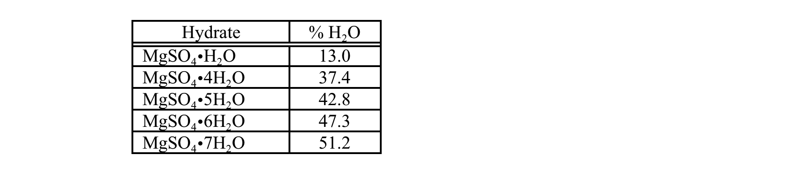
Hydrate: % Water
EPSOM SALT(s)
% MgSO₄
87.0
62.6
57.2
52.7
48.8
A
B

Slide 30

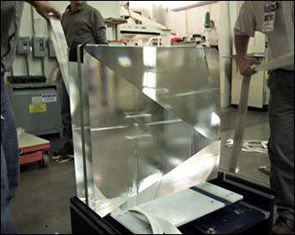
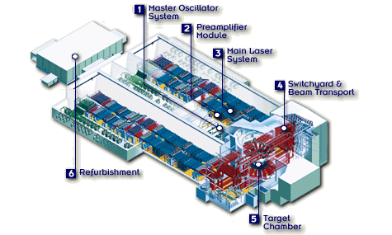
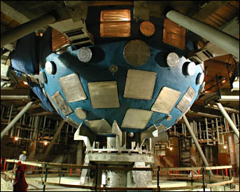
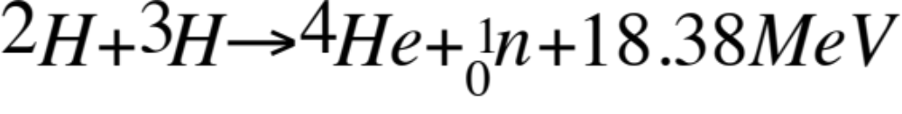
“Salt” / NIF / Fusion
What is “salt”?
potassium dihydrogenphosphate
sodium chloride
5 grams of hydrogen will produce enough energy to boil over 1,000 gallons of water

Slide 31
Nomenclature / Naming
Nomenclature: the unambiguous naming of compounds/ molecules
Governed by the IUPAC: International Union of Pure and Applied Chemistry
International rules are updated periodically
https://www.iupac.org/fileadmin/user_upload/databases/Red_Book_2005.pdf
Organic and Inorganic compounds/ molecules have separate naming rules.

Slide 32
Nomenclature & Formulas
Today’s Experiment
What’s My Formula?
http://www.chemconnections.org/general/chem108/Nomenclature.htm
Reactant (Possible Unknowns) | Salt Product
a) sodium hydrogen carbonate | Na₂CO₃ name: ?
b) potassium hydrogen carbonate | K₂CO₃ name: ?
c) barium chloride dihydrate | BaCl₂ name: ?
d) calcium sulfate dihydrate | CaSO₄ name: ?
On each Report Form write the formulas for each Reactant and the name of the corresponding Product as shown on next slide

Slide 33
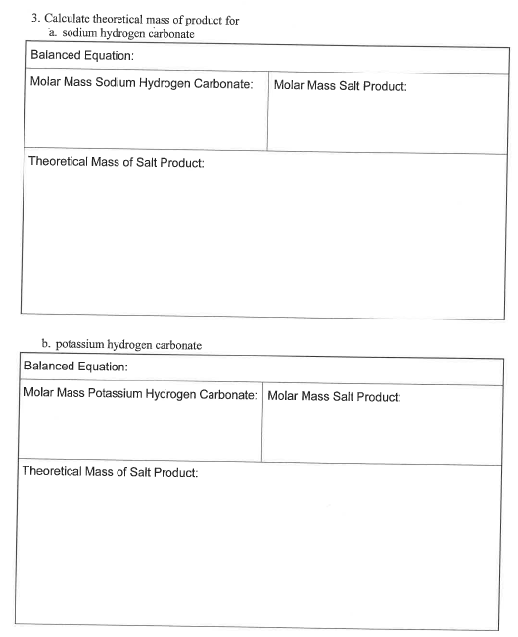
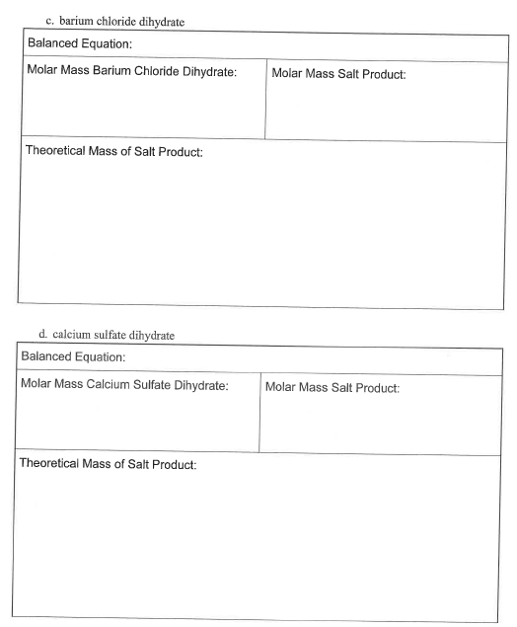
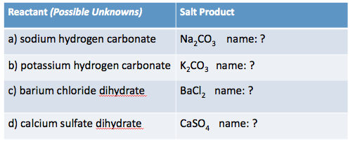
Nomenclature & Formulas
http://www.chemconnections.org/general/chem108/Nomenclature.htm
Write the formulas in the boxes on your form noted below, and the names of the Products in the respective boxes next to them. Review everyone’s formulas and names for correctness.

Slide 34
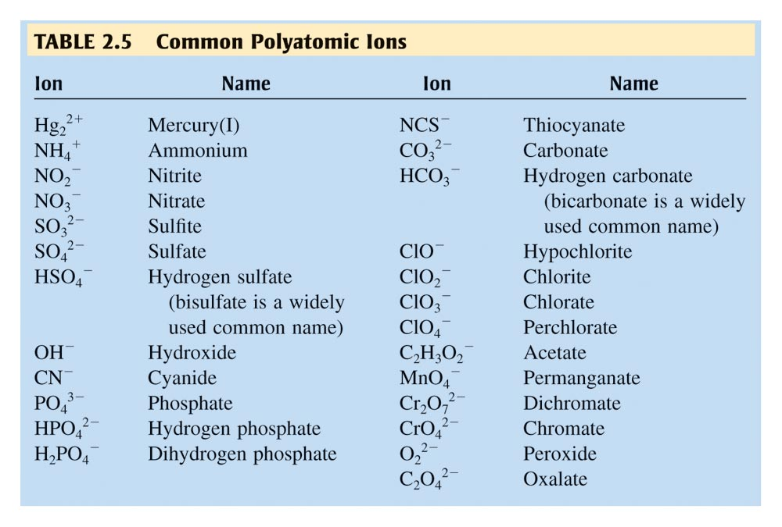
Compounds with more than two different elements
Polyatomic ions: http://chemconnections.org/general/chem120/polyatomics.html

Slide 35
Nomenclature & Formulas
Today’s Experiment
What’s My Formula?
http://www.chemconnections.org/general/chem108/Nomenclature.htm
NaHCO₃
sodium carbonate
KHCO₃
potassium carbonate
BaCl₂.2H₂O
barium chloride
CaSO₄.2H₂O
calcium sulfate

Slide 36
Nomenclature & Formulas
http://www.chemconnections.org/general/chem108/Nomenclature.htm
Each of you choose 1 of the possible unknowns a., b., c., or d.
Be sure the choices are all different.

Slide 37
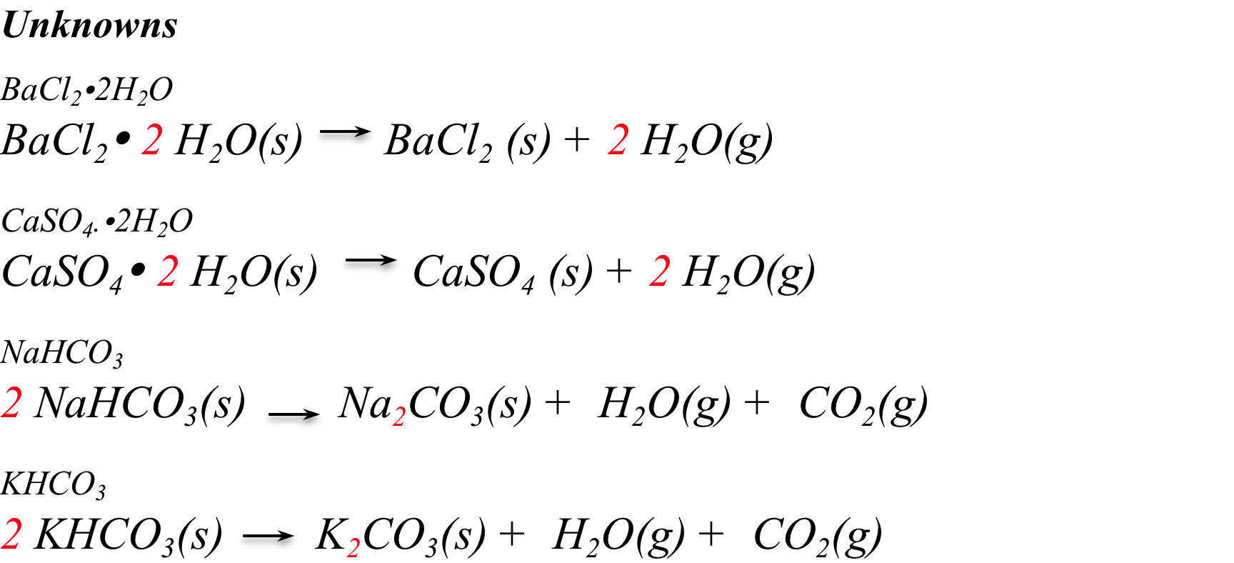
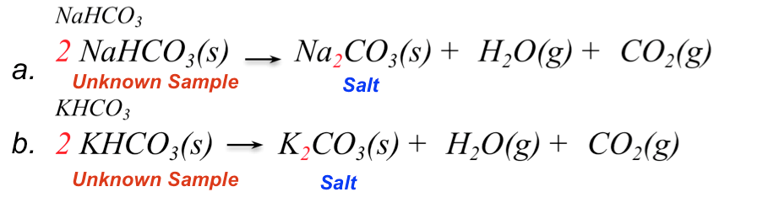
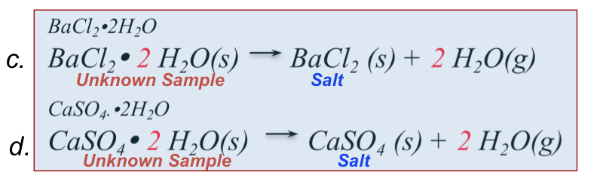
What’s My Formula?
c.
Unknown Sample
Salt
d.
Unknown Sample
Salt
a.
Unknown Sample
Salt
b.
Unknown Sample
Salt
Write the equation for your chemical reaction exactly as it is written above for your unknown on your form in the Balanced Equation box.

Slide 38
Nomenclature & Formulas
http://www.chemconnections.org/general/chem108/Nomenclature.htm
Select the formula for the salt product that is produced from heating your unknown and clearly show a labeled calculation of the respective molar masses of the Reactant and the Product. Record the molar masses of all eight compounds on each individual form: 4 starting reactants and 4 salt products.

Slide 39
What’s My Formula?
1
1
Unknown Sample
Salt
1
1
Unknown Sample
Salt
?
1
Unknown Sample
Salt
?
1
Unknown Sample
Salt
Theoretical Calculations for Hydrates:
1 mole hydrate = 1 mole Salt Product (Unknowns c. and d.)
Theoretical Mass of Salt Product = Molar Mass of Salt Product
________________
Unknowns a. and b. 1 mole hydrogen carbonate = ½ mole Salt Product

Slide 40
What’s My Formula?
As a Group, calculate the Mass Percent Composition of the salt products relative to the respective starting unknown in each of the 4 possible unknowns: their respective Theoretical Mass equals the Molar Mass.
Note that sodium hydrogen carbonate and potassium hydrogen carbonate have to include an adjustment for the difference in the number of moles produced relative to the starting reactant. Example:
1
Unknown Sample
Salt
Theoretical Calculations for hydrogen carbonates:
Mass Salt = Molar Mass Salt (g/mol) x mol_{salt} / mol_{HCO3-}
1 mole hydrogen carbonate = ½ mole Salt Product
1
2
Mass % Salt = Theoretical Mass Salt / Molar Mass_{unknown} x 100

Slide 41
Theoretical Mass &
Mass % Salt Product
Show clear calculations for the Mass % of the respective Salt Products for each of the 4 unknowns a., b., c., & d. Circle or highlight the Mass % for the unknowns on your form as shown below.
Mass % =
Mass % =
Mass % =
Mass % =

Slide 42
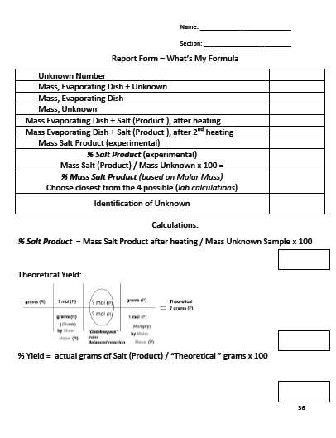
Your group is to obtain a minimum of 2 unknowns up to a maximum of 4 or 5 unknowns from Dr. R., then complete the procedure. Each of you will complete a data form for one unknown (replaces pg. 36)
What’s My Formula?
When your Group has completed the Mass % calculations, bring all of the completed pages to Dr. R. to get your unknowns.

Slide 43
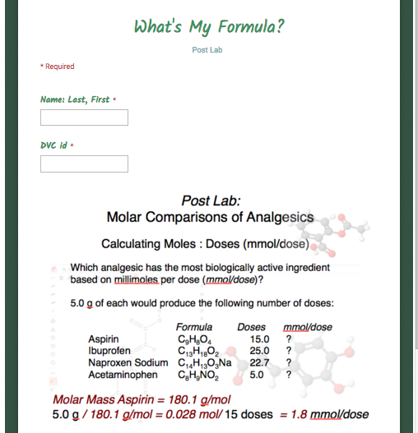
On-line Post Lab: submit by end of next week
http://chemconnections.org/general/chem108/What's%20My%20Formula.html

Slide 44
What’s My Formula? Identificaton
85.26%
Unknown Sample
Salt
79.09%
Unknown Sample
Salt
63.08%
Unknown Sample
Salt
69.02%
Unknown Sample
Salt
Experimental Calculation: (After completing the heatings)
Comparison to Mass % Calculations for a, b, c, d

